Slide 1
Safer Neighborhoods through Precision Policing Initiative: Officer Safety and Wellness
Performance & Recovery Optimization (PRO)
Brandi Burque, Ph.D.
Licensed Police Psychologist
San Antonio Police Department
CNA Consultant
March 14, 2018

Slide 2
Objectives
Discuss the need for performance optimization training for law enforcement agencies
Identify the key skills taught in PRO
Review the importance of utilizing a “cop and doc” approach to the development and implementation of officer wellness programs
Identify ways this has been implemented:
  San Antonio Police Department
  South Dakota Highway Patrol
  Hennepin County Sheriff’s Office (Minneapolis, MN)

Slide 3
In Collaboration With…
Deloria R. Wilson, Ph.D.
Operational Psychologist
Air Force Security Forces
Lackland AFB, TX

Slide 4
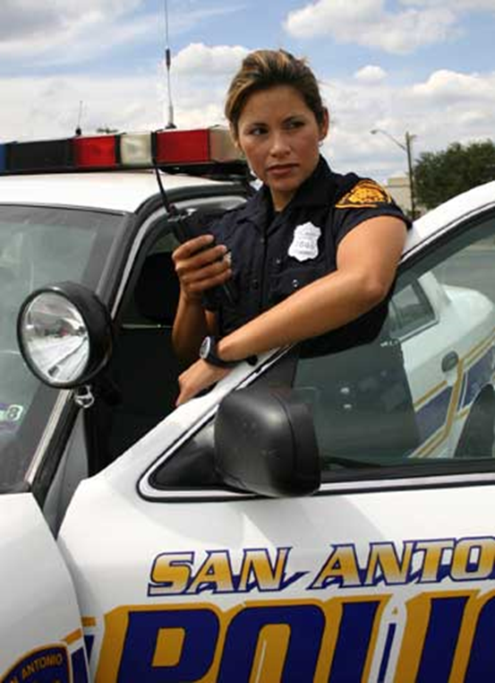
Performance
Optimization

Slide 5
Performance Optimization: The Need for Precise Language
Using the word “performance” instead of “stress management” or even “wellness” has practical benefits; more tangible
Focusing on performance in any given situation IS mindfulness
Using athletes as an example; everyone wants to know how to perform better at everything they do

Slide 6

Cop and Doc
A Collaborative Culturally Aware Approach
(Wilson & Burque, 2016)

Slide 7
Shared Expertise
Science is translated and integrated fully within the department
  Doc may know “the what and why”
  Officers know “the how”; to translate the science into tactical environments in language that is more easily accessible to target audience
Doc becomes integrated in various aspects of the department to help facilitate training, address real stress inoculation principles, return-to-duty, etc.

Slide 8
SAPD COPS & DOC
Co-Writer/Instructor:
  Officer Cliff Burns (East Patrol)
Co-Instructors:
  Officer Jesse Noriega (SWAT)
  Officer William Kasberg (MHU/CIT)
  Officer Shannon Purkiss (MHU/CIT)
  Officer Rene Salas (Academy-Tactics)
  Officer Annie Salinas (Academy-Tactics)
  Officer Richard Odoms (Academy-Tactics)
  Officer Juan Mandujano (Academy-Tactics)
  Officer Daniel Loudermilk (Academy-Tactics)
  Officer Joel Pope (Academy-Driving)
  Officer Arturo Castellanos (Academy-Driving)
  Detective Carl Kerawalla (Property Crimes)
Guest Speakers:
  Detective Mark Harris (Applicant Processing—Cardiovascular Disease)
  Officer George Bonilla (Patrol—Critical Incident Stress/OIS)
  Officer Nate Becerra (Patrol—Critical Incident Stress/OIS)

Slide 9
What is the Purpose of PRO?
Integrated “stress management” program incorporating research, theory, and skills from military, law enforcement and sports psychology.
Goals of the program
  Make policy based on science not politics
    Brain study and its implications on fine motor skills and use of force
    Visual cognition (water bottle example)
  Enhance officer’s performance on the job
  Enhance officer’s performance at home
  Prevent and/or mitigate officer burnout
  Create a culture based on performance enhancement where byproducts of this include PTSD prevention, suicide prevention, and mental health wellness

Slide 10
Performance and Recovery Optimization (PRO) for SAPD
Cadet Training
  8 to 10 hours of didactic lecture on the survival stress response system and ways to modulate the stress response
  Zombie exercise
  Operation exercise
  Integrated briefs/debriefs in driving, tactics, firearms, Hell Day and Stress Day
In-service 2016
  6 hour didactic style lecture on SSR and modulation tactics with Operation and Zombie exercise
Professional Development starting in 2017
Return-to-Duty Program

Slide 11
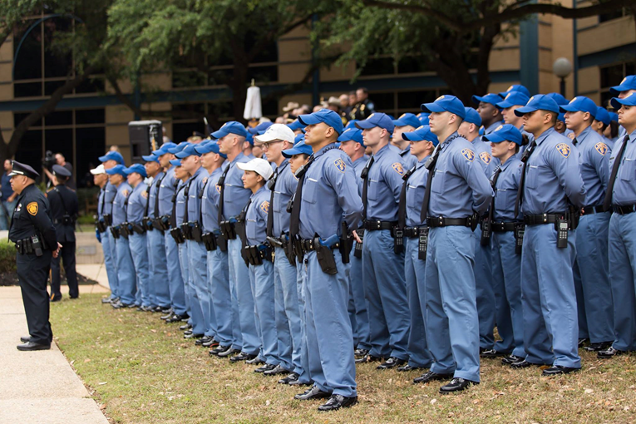
Core Concepts

Slide 12
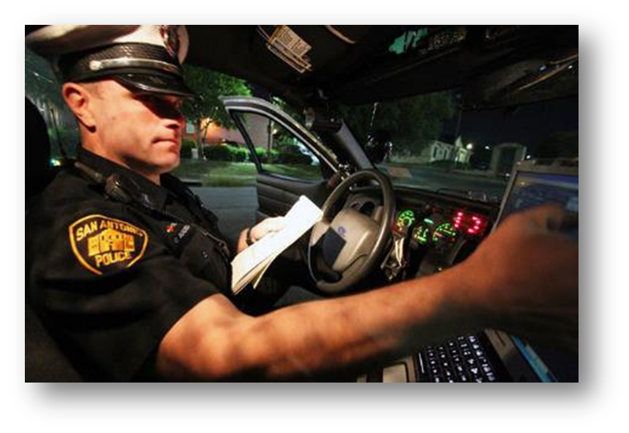
Skills
Survival Stress Response & SSR Tactics
  Tactical Breathing
  Muscle Control
Advanced SSR Tactics
  Performance Self-Talk
  Mental Practice
  Attention Management
  Winning Mindset/Stoic Operating System
Recharging
  Sleep optimization
  Nutrition/Fitness
  Decompressing from work

Slide 13
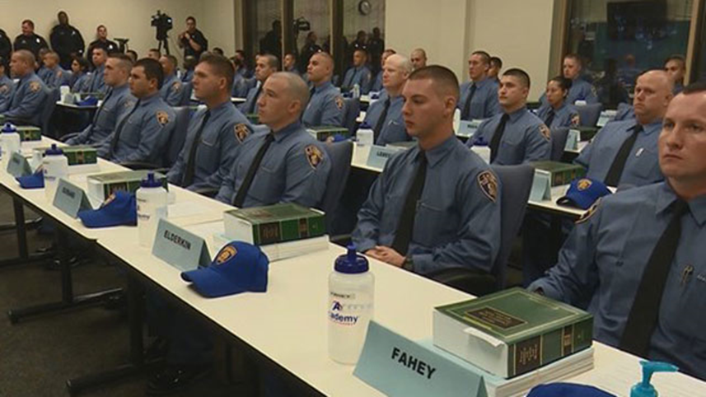
Integration
Academy
  Cadets
  In-service
Daily Bulletin
Wellness boards in each substation
3 Day Course for professional development
Post-critical incident defusings/debriefings
  OIS officers place at Academy

Slide 14

SNPPI
SDHP & HCSO

Slide 15
South Dakota Highway Patrol
Conducted 2 day training (November 2017)
  1st day brief training in PRO modules
  2nd day focus group with key stakeholders in developing a wellness program
Conducted needs assessment
  What resources are available and what needs to be obtained
  Identified key parts of their wellness program
Interest in program development from across department
  Projected week long training for peer support and PRO training; scheduled May 2018

Slide 16
Hennepin County Sheriff’s Office
Conducted 1 day training (February 2018)
  Brief 8 hour training in PRO modules
Conducted needs assessment
  What resources are available and what needs to be obtained
  Identified key parts of their wellness program
    *Main take-away is the need for a consistent MH provider to help with peer support, officer debriefs after critical incidents and therapeutic services
Interest in program development from across department
  Projected week long training for peer support and PRO training; TBA

Slide 17
Questions/ Contact
Brandi Burque, Ph.D.
San Antonio Police Department
CNA Consultant
Licensed Police Psychologist
954-802-7419
brandipro2016@gmail.com

